Slide 1
Simon Turner
RoadSafe Campaigns Director

Slide 2
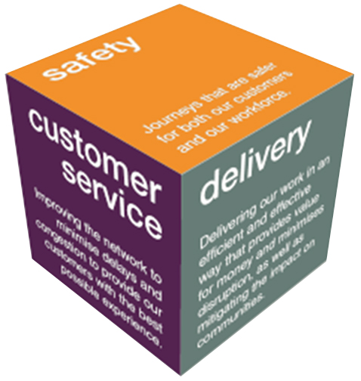
Highways England
Government company charged with operating, maintaining and improving England’s motorways and major A roads
Three business imperatives
Safety
Customer service
Delivery
Notes:
Many businesses look at these items, especially maintenance and fuel, and don’t link it to driver and vehicle performance. Better management of drivers and vehicles can bring all these costs down significantly.

Slide 3
Driving for Better Business
2001 – DfT/HSC focus on WRRS
2005 – Motorist’s Forum Report
2007 – DfBB launched to improve WRRS in both public and private sector
2015 – HE begins to support DfBB
2017 – HE commits £750k for next 3 years
Notes:
2001: KSIs were much higher with approx. 3000 fatalities per year. Department for Transport/Health and Safety Commission understood that a third of these were thought to involve someone driving for work (from Stats19 data) and started to look at how they could engage employers.
2005: They commissioned The Motorists Forum to look at how to encourage employers to improve work-related road safety (WRRS). The report advised that many business owners and managers were too focused on building the business and that road safety messages didn’t resonate. The report advised that the only way to engage employers was to talk about the business benefits such as cost reduction and improved efficiency, and do so using other successful businesses as advocates, sharing their stories as case studies through established business networks.
2007: DfBB was launched by the Department for Transport with a small amount of funding.
2015: Following some years of neglect and underfunding, Highways England provided some support to the DfBB campaign along with help and resource to expand the campaign which proved successful.
2017: Having seen how DfBB could help support a number of HE road safety initiatives, HE committed over £750k for the three years to 31 March 2020.

Slide 4
Campaign Supporters
Notes:
I have included HE here however it is important to reinforce that DfBB is Highways England’s Campaign!
The other organisations support our aims and work with us to promote WRRS
HSE – Health and Safety Executive
APSE – Association for Public Sector Excellence
AIRSO – Association of Industrial Road Safety Officers
FTA – Freight Transport Association
ACFO – Association of Car Fleet Operators
BVRLA – British Vehicle Rental & Leasing Association
IOD – Institute of Directors

Slide 5
British Road Safety Statement
Key priorities include
Reduction in work-related road collisions
Faster uptake of safer vehicles – AEB
Support HE & LAs to improve safety standards throughout the public and private sector
Notes:
The British Road Safety Statement was released in 2015 and contains a number of specific objectives and ambitions relating to driving for work.
The line about supporting Highways England and Local Authorities to improve standards in the private and public sector is key – see next slide

Slide 6
British Road Safety Statement
Road safety is not just a matter for government and the public sector. The safe movement of goods and services is vital for the national economy and industry as a whole. As around a third of road traffic collisions involve a person at work, there is more that we can do working with industry and the rest of government to support and promote good practice in safer fleet management and occupational road safety.
Notes:
Public sector bodies already do good work in promoting road safety in their local regions however there is clearly an assumption that those local authorities already manage WRRS in their own organisation to the required level and this is simply NOT the case. Some organisations so manage WRRS well but some also have gaps – it is essential that we all practice what we preach. Highways England has recently risk assessed its driving for work activities across the organisation and launched a new driving at work policy with the full support of the CEO and the Board of Directors.

Slide 7
Engaging the Public Sector
Six new DfBB regional managers recruited
Required to engage SRP members
Support them in engaging local business
Help them ensure compliance themselves
Notes:
Highways England is looking to support public sector employers to improve standards of WRRS locally and has hired a number of regional managers to provide this support locally.

Slide 8
The DfBB Mission
To demonstrate the dramatic business benefits of managing work-related road safety more effectively
Better Management = Cost Reduction!
Notes:
DfBB was formed in 2007 following research by DfT/HSE and the Motorists Forum.
The aim of the campaign is to identify Business Champions who manage their work-related road safety (WRRS) well and to share their stories as an inspiration to other employers, encouraging them to improve their own businesses in order to achieve similar benefits.

Slide 9
Business Champions
Relieving Budget Pressure
On the Public Sector
Notes:
DfBB is not just about businesses – it is equally relevant to the public sector who are under intense and constant pressure to reduce costs and work within ever-tighter budgets.
DfBB can help this process by applying it across both the organisation itself, and ensuring suppliers follow it too.

Slide 10
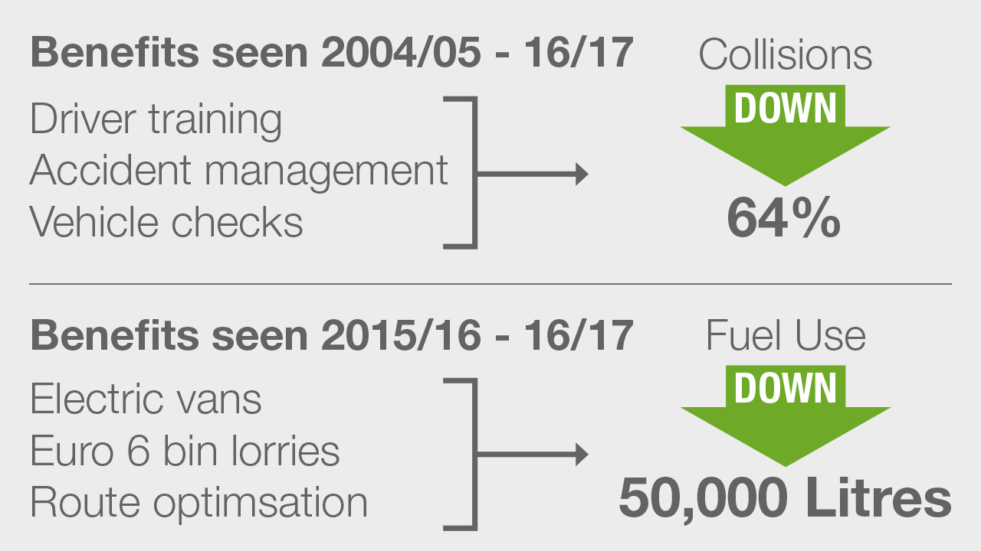
Notes:
Gateshead have seen a variety of costs come tumbling down.
A 64% reduction in collisions = massive reduction in repair costs, replacement hire costs, maintenance costs and staff absence.
50,000 litres reduction per year at £1.20 per litre is approx. £60,000 per year reduction in fuel spend – in just one year

Slide 11
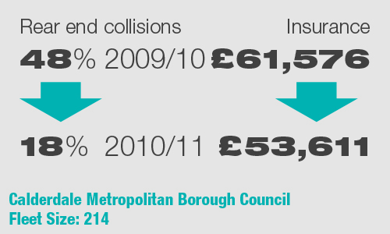
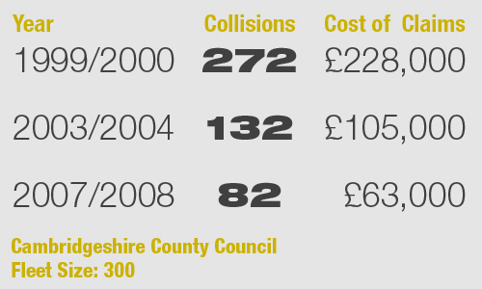
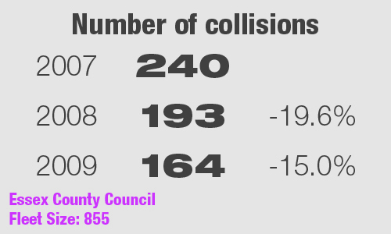
Other Public Sector Champions
Notes:
Other public sector business champions include the above organisations.
Some of these are quite old as the organisations became champions quite a few years ago. We are working to update these as quickly as possible.

Slide 12
Your Supply Chain
Notes:
Ensuring your supply chain is compliant can bring additional benefits.

Slide 13
These are legal requirements!
Management of H&S Regulations 1999
Health and Safety at Work Act 1974
Section 2 – duty of care to employees
Section 3 – duty of care to others
Section 37 – manager’s duty to implement policy
Section 7 – employee’s duty to follow policy
Notes:
There is no law which states each individual action that a company must take – instead, the onus is on the employer to take guidance from the HSE and interpret duty of care from the Health and Safety at Work Act. There are also other pieces of relevant legislation such as the Road Traffic Act.
The Management of Health and Safety Regs states that an employer must risk assess all its activities to ensure they don’t pose a risk to staff or others – this includes driving for work.
The Health and Safety at Work Act states that an employer must ensure that work practices don’t put staff or others at risk. Section 2 and 3 are ‘employER’ offences – many recent cases have seen fines in excess of £1 million.
Section 7 and 37 are ‘employEE’ offences and can see individuals go to prison and directors be struck off.
A good example to cite is that an employer must not create work schedules or incentivisation staff in ways that encourage or require drivers to speed in order to meet them.

Slide 14
Is your supply chain compliant
Are you spending taxpayers money on non-compliant suppliers?
Compliant suppliers are likely to have
Lower overheads passed on to clients
Happier staff
More reliable service
Notes:
As we have see that it is a legal requirement to manage WRRS correctly – public sector organisations really shouldn’t be awarding contracts, and taxpayers money, to private sector suppliers that are not managing their WRRS in a compliant manner.
A powerful incentive to demand compliance in the supply chain is that better managed suppliers will have lower overheads and better managed staff, and can therefore provide a higher quality, more reliable service at a lower cost.

Slide 15
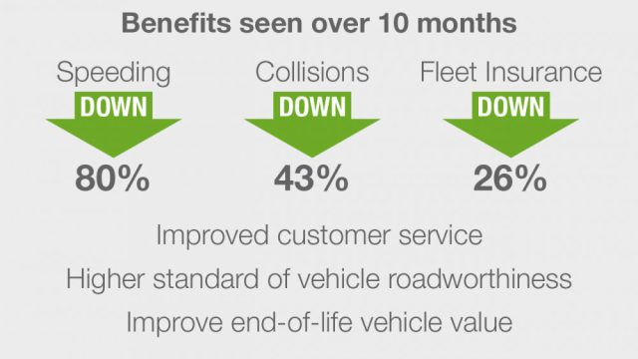
Notes:
HILS provide mobile social care (meals on wheels and home visits) for local authorities.
Reducing their costs means they can now tender a safer, better quality and more reliable service at a lower cost because they have reduced their fleet overhead

Slide 16
Highways England leads by example
Tier 1 contractors must be
DfBB Business Champions by March 2019
They must ensure their supply chains are compliant
Not Compliant? Not Welcome!
Notes:
Imposing better standards on your supply chain may seem difficult at first glance however Highways England have now managed to do just this.
All Tier 1 contractors must be DfBB Champions by March 2019.
All companies in the Highways England supply chain below this level must manage their WRRS to at least the minimum level suggested by HSE guidance, whether they are contracted direct to Highways England, or part of a Tier 1 supply chain.
Highways England have said to their suppliers “We are not prepared to work with you if you don’t do things properly”

Slide 17
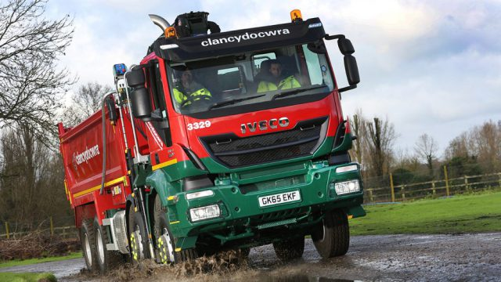
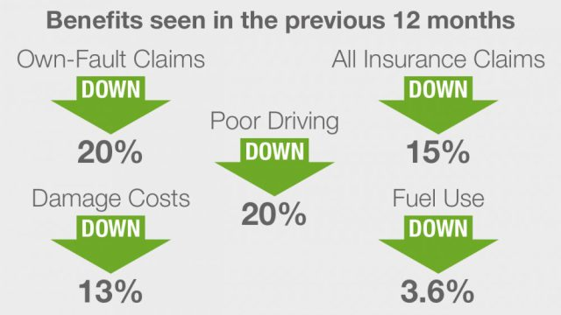
Notes:
Clancy is part of the Highways England supply chain, and also works for many local authorities.
Their benefits in just 1 years are dramatic and have mainly been achieved through a new driving at work policy, driver training and the installation of telematics in their vehicles.

Slide 18
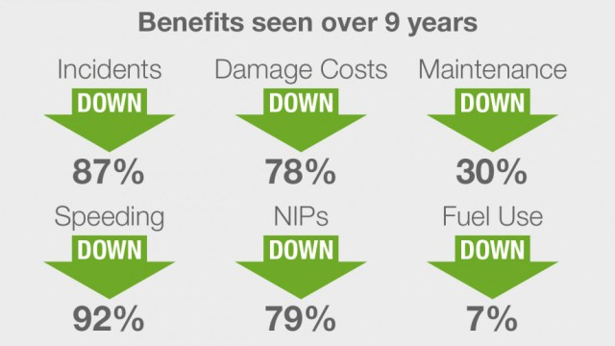
Notes:
Iron Support many organisations with document and information storage
Widely recognised as one of the best fleet management teams in the country, and indeed Europe.
Mainly achieved through new policy, driver training and telematics
They class a speeding event as going 5mph over the posted limit and, on average, each driver does this no more than once every two weeks! (data from telematics)
Proof that they don’t have to speed to meet their service delivery target of 99.97%

Slide 19
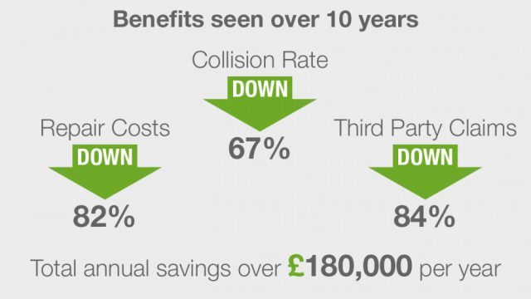
Fleet Size = 220
Grey Fleet = 280
Notes:
Arval is one of the UK’s leading vehicle leasing companies
Great staff engagement, policies and procedures, including ban on mobile phones whilst driving have contributed to their results
Repair costs and third party claims are just part of the picture though – uninsured costs are generally between x4 and x32 the cost of the repair.
This means that when you add in admin ana management time for dealing with the incident, temporary replacement for vehicles and drivers, and the cost of staff absence, their savings are likely to be well over £500,000 per year

Slide 20
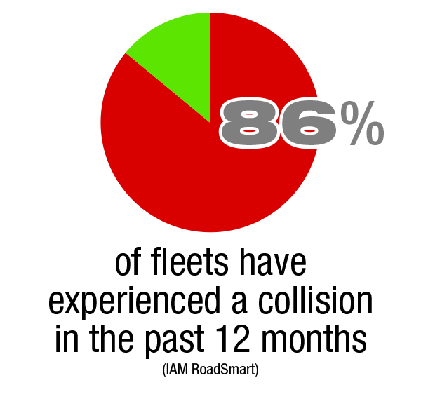
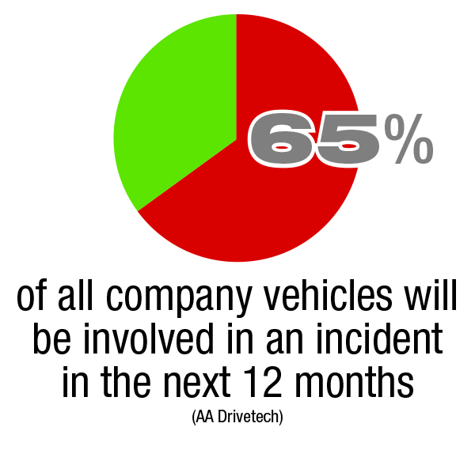
How likely is an employer to be affected?
Notes:
The IAM surveyed their own fleet customers for the first graph. The AA Drivetech’s results were based on historic data from their fleet customers.
The chances of any fleet avoiding a collision of any kind, and therefore the associated cost, are very slim indeed.

Slide 21
Just the cost of operating?
Fleet insurance premium
Damage repair costs (accidents happen)
Maintenance and repair costs
Fuel use
Notes:
Many businesses look at these items, especially maintenance and fuel, and don’t link it to driver and vehicle performance. Better management of drivers and vehicles can bring all these costs down significantly.

Slide 22
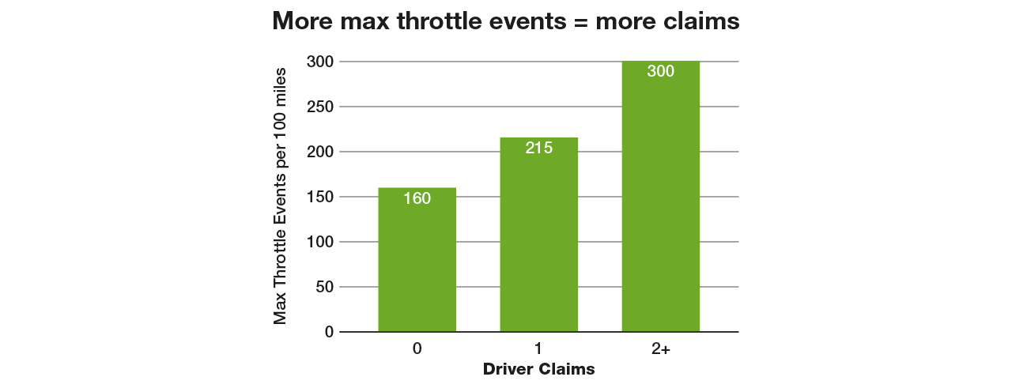
Notes:
AA Drivetech – the fleet risk management and driver training consultancy owned by the AA – looked into the telematics data from the AA’s roadside recovery fleet and found some startling data.
Telematics systems provide data on the number of times a driver put his foot to the floow (Max Throttle Event) as well as measuring harsh braking and cornering, idling time, fuel use, etc.
They found a clear link between max throttle events and crashes so if they see a driver indicating over 200 max throttle events per 100 miles, who hasn’t had an accident, they know to bring him in for training because the data says he will have a crash eventually.

Slide 23
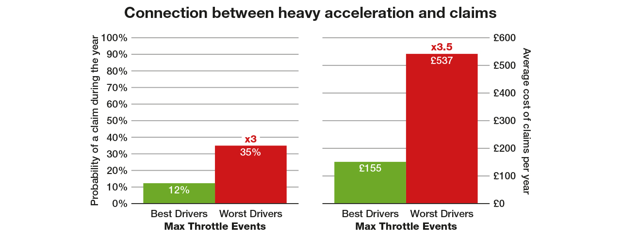
Notes:
Linking this information to costs, we see that the worst drivers for Max Throttle events are three times more likely to crash and the crash will be 3.5 times more expensive. Therefore if you were to add up the costs of all the crash costs, those who were the worst offenders for Max Throttle events would account for 90% of the costs. This is a clear benefit of measuring and monitoring – it is clear when action can be taken to significantly reduce costs.

Slide 24
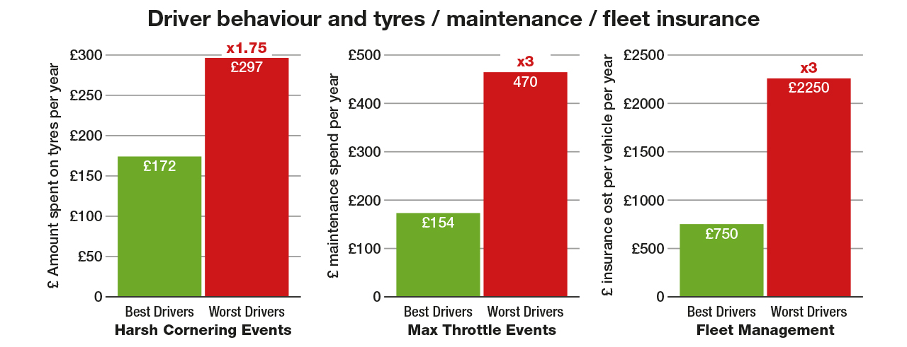
Notes:
The data also showed that the poorest drivers were also spending nearly twice as much on tyres and three times as much on routine servicing and maintenance. The cost of fleet insurance can vary widely as a direct result of your drivers poor driving and collision history.

Slide 25
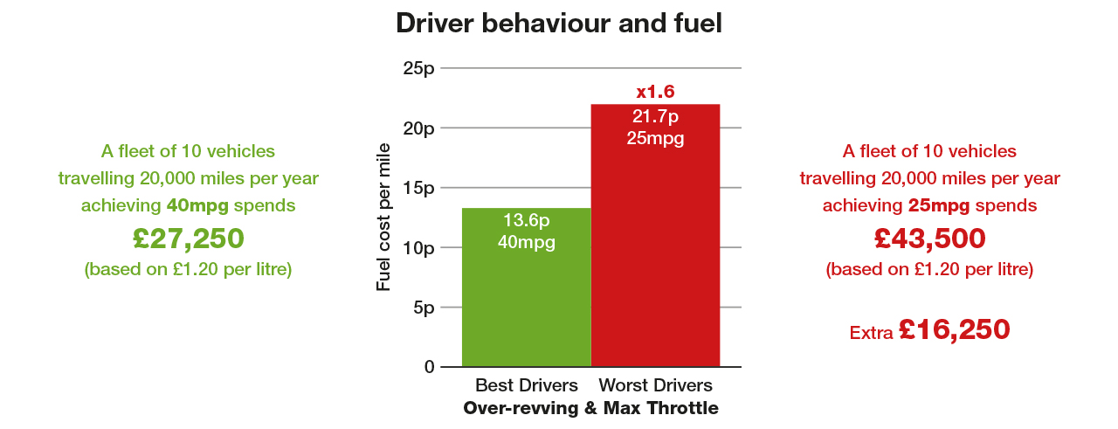
Notes:
Poor driving also means a hefty increase in fuel use. Average consumption obviously varies considerably depending on type of vehicles and journeys. As we saw in the Gateshead study, a variety of measures saw them reduce their fuel bill by £60,000 per year

Slide 26
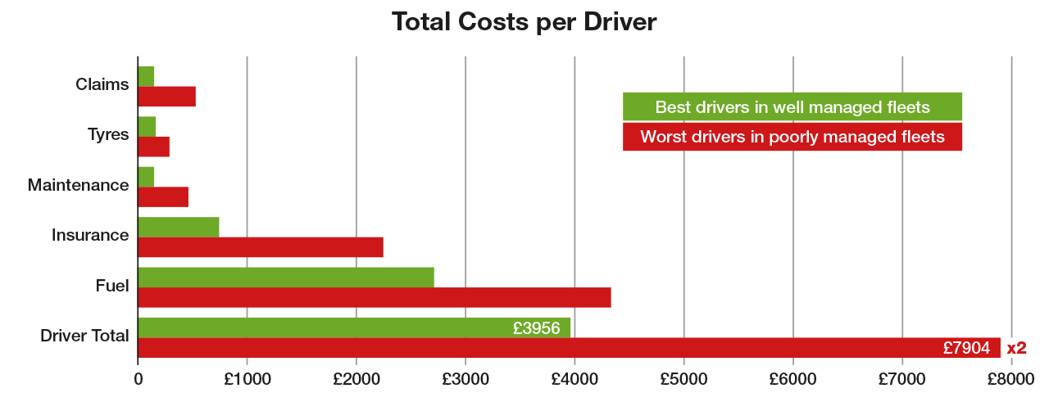
Notes:
Adding up all those figures shows that a poorly managed driver can easily be costing their employer twice the annual amount of a poorly managed, poorly performing driver.

Slide 27
Getting the basics right
Managing work-related road safety starts here
Risk assessment / compliance gap analysis
Top-level management support
Driving at Work policy
Measuring and monitoring
Ensuring consistent application
Notes:
All our champions pursued best practice, but they started with these 4 essential elements of compliance in WRRS

Slide 28
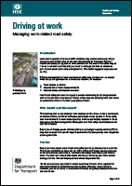
Supported by the HSE
INDG382
Driving for Work
INDG199
Workplace Transport
Safety
Notes:
These are based on meeting current guidance from the HSE on Driving for Work and duty of care obligations in the Health and Safety at Work Act 1974.

Slide 29
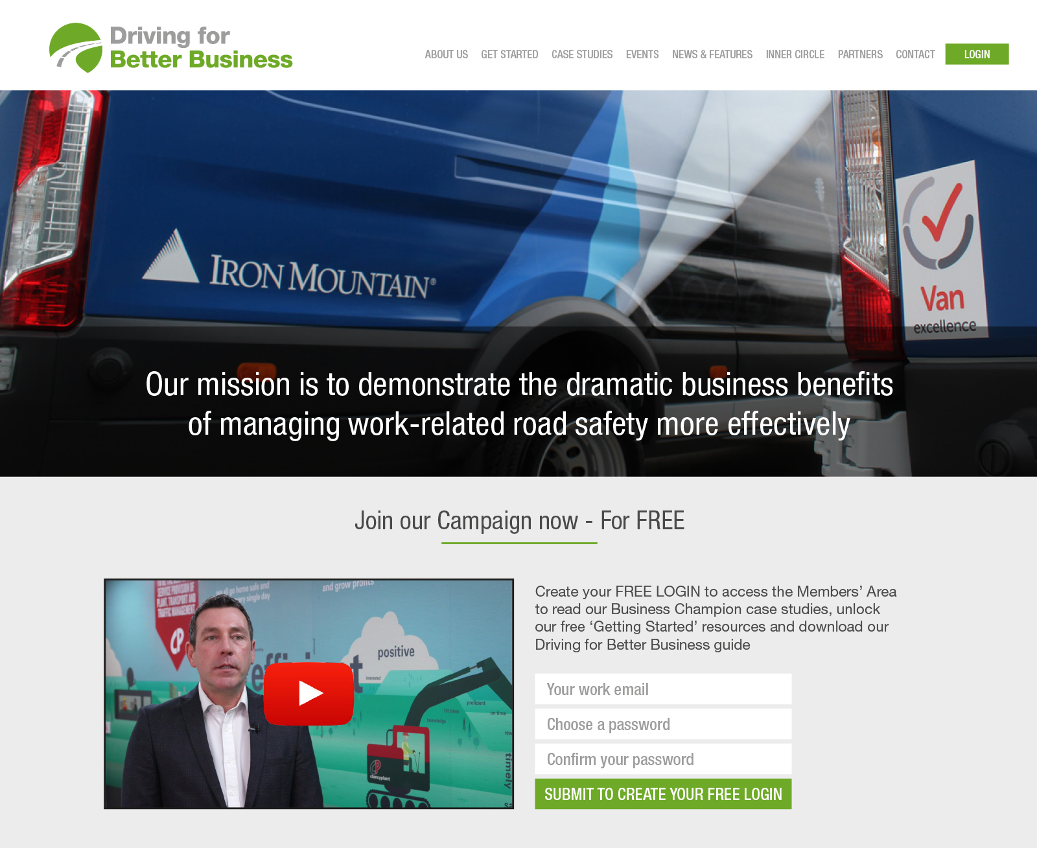
Notes:
The next step is to visit the DfBB website
Register on the website to access the full case studies and free resources
Encourage as many of your suppliers as possible to also sign up on the website
The website and all the resources are completely free to use

Slide 30
Notes:
We just mentioned the four essential steps of compliance under HSE guidance – the website offers an entirely free resource for each.

Slide 31
The DfBB Commitment
Promote to your stakeholders
Improve WRRS
Reduce damage
Reduce wear and tear
Reduce penalties
Notes:
If you and your suppliers meet all four requirements you can sign the DfBB commitment – self-declaration that you manage your WRRS compliantly.
This is free and is a self declaration – you won’t be audited and your details won’t be published anywhere. What it does is provide is an automatically generated certificate that suppliers can then show to you.
This is an easy way for you to check supply chain compliance and you can randomly check their policies or risk assessments to ensure compliance.
Highways England now want all their suppliers to sign this commitment – no company in the HE supply chain should be operating outside the law.
Anyone making the DfBB Commitment will also get free membership and access to the DfBB ‘Inner Circle’ on the website with features and resources for employers looking to improve even further.

Slide 32
Champion Policies
Login at www.drivingforbetterbusiness.com
Notes:
Additionally, many of our Business Champions have provided copies of their driver policies and handbooks for you to use as inspiration. They have created these documents to help make their drivers safer. They are happy to share them with you because their drivers and your drivers share the same roads.

Slide 33
Engaging businesses
in the community
Notes:
Whether you work for a local authority or the emergency services, many of your colleagues will be part of local Safer Roads Partnerships, and promoting better fleet safety to businesses in your local area.

Slide 34
Do as I say, not as I do?
Other road safety partners also need to step up
SRP, FRS, LA, PCC
Notes:
It is therefore essential that you practice what you preach.
The first picture shows an event DfBB did to engage local business with Kent Safer Roads Partnership, with support from the Kent County Council, and both the Fire and Police services.
Picture 2: There are now a number of pilot schemes being run by police forces across the company, some independently and some in conjunction with Highways England. They are specifically targeting those who are obviously driving for work such as those in sign-written cars and vans. If they stop a van driver for, say, suspected vehicle checks they will ask the driver if he is driving for work, and then ask what his employer’s driving for work policy says about vehicle maintenance. If he says he has never seen a policy, the aim is to not punish the driver, but to go and encourage the employer to ensure they have everything in place and offer DfBB resources to help. If the employers is a repeat offender, and refuses to change, there is the option to then come down harder on the employer and target their fleet through ANPR. The ultimate aim is to deny access of the roads to those employers who repeatedly put other road users at risk with dangerous drivers, vehicles or work practices.

Slide 35
Thank you
Any questions?

